Slide 1

Offensive Security in Action: Strengthening Defense Through Malware-Based Offense

Slide 2

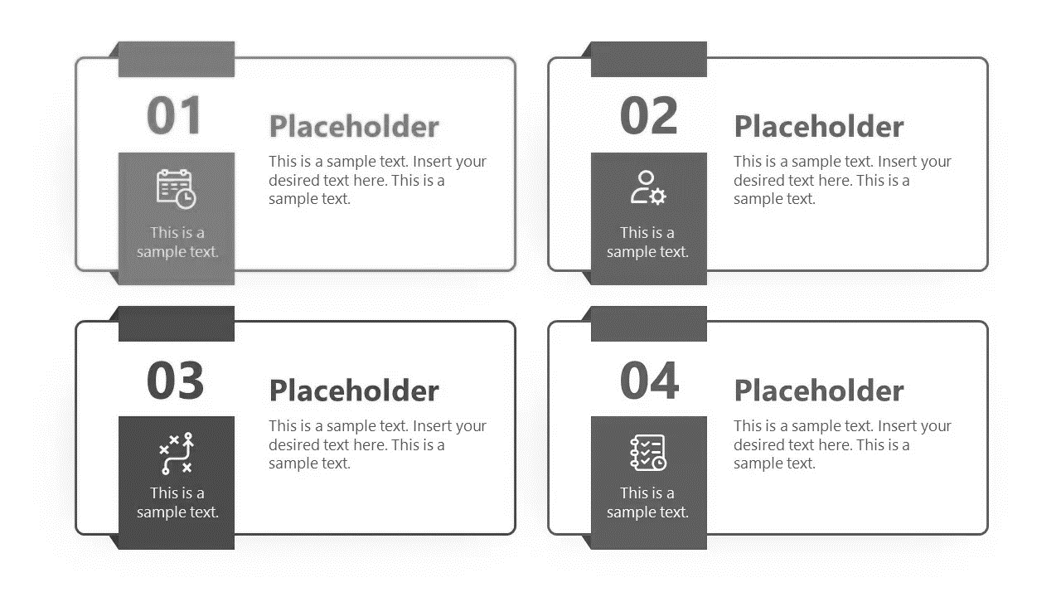





Presentation Structure
Introduction
The Problem & Scenarios
Our Goal & Approach
Attack Chain
Anti-virus Bypass Techniques
Pointer Obfuscation
Unhooking
Malware Capabilities
Keylogger
Hardware Extractor
Data Exfiltration via Telegram
Walkthrough
Timeline
Results
Execution walkthrough

Slide 3
The Problem
The Human Factor!!!
Modern defenses are failing against user’s awareness which being abused by malwares.
This threat grows massively by the use of untrusted files and cracked software across both individuals and government institutions, silently introducing malware designed to steal credentials, monitor user activity and even infiltrate national infrastructure.

Slide 4
APT
Advanced Persistent Threat
An (APT) is a threat actor, typically a state or state-sponsored group. The term may also refer to non-state-sponsored groups conducting large-scale targeted attacks for specific goals.

Slide 5
Scenario
APT keylogging is not a tool of attack; it's a tool of occupation.
(APT) actors deploy malwares as tools for long-term surveillance, not for immediate damage, but for strategic, persistent infiltration.
North Korea APTs!!!
To supplement its economy, the government used hackers for fundraising, targeting wherever a financial opportunity happens to lie.
Profits: $400M in 2021, $600M in 2022.
50% of Income from Cyber-Attacks (US Congress)

Slide 6
Our Goal
Simulate real world threats.
Expose weakness in existing security controls.
Increase security awareness.
Improve Incident response readiness.

Slide 7
Our Approach
Developing a controlled, proof-of-concept malware that simulates real-world attack techniques by continually harvesting data while evading AVs to ethically test and reveal weaknesses in modern cybersecurity defenses.
Bypassing AVs?
Unhooking, Sandbox and VM detection & Pointer Obfuscation.
Malware Capabilities?
Target profiling, Fileless keylogging & Data exfiltration via telegram

Slide 8
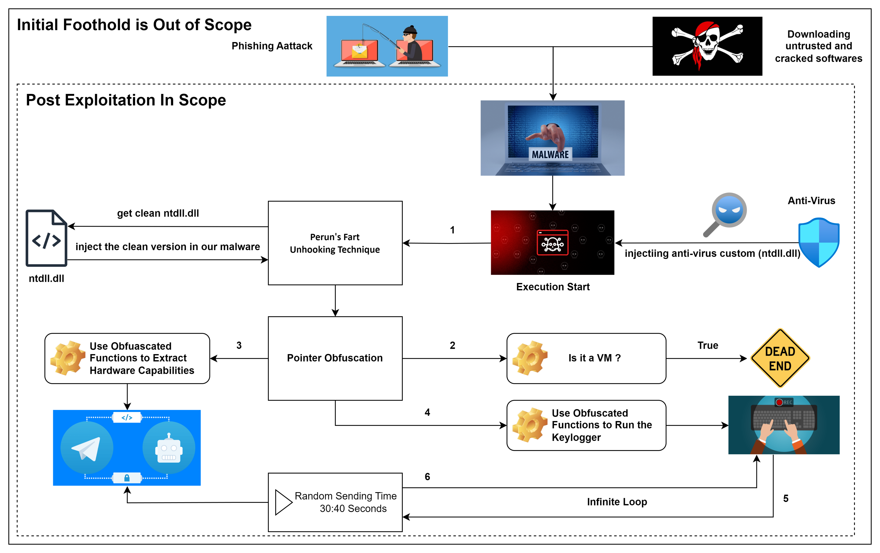
Attack Chain

Slide 9
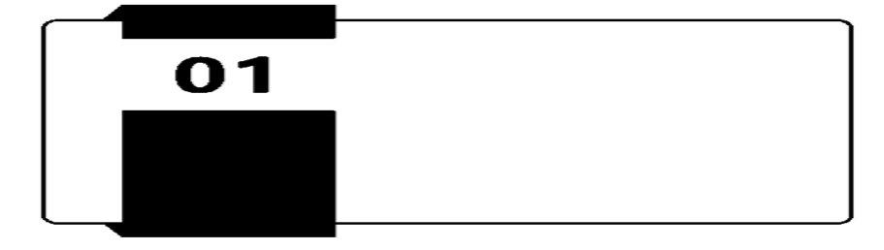
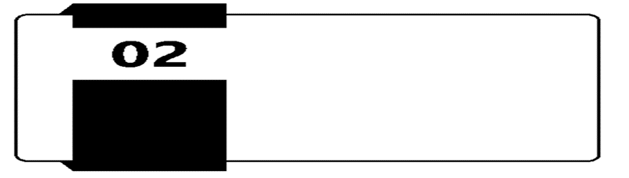

ANTI-VIRUS BYPASS Techniques
Static Analysis Evasion
Behavior Analysis Evasion

Slide 10
Static analysis evasion
Problem:
Our Solution is obfuscation:
Static analysis detects strings
API (DLL - Function) names visible in import table
entropy reveals suspicious patterns
Transform the suspicious string to benign one
Pointer Obfuscation
Offset-Based Encoding - Transform the suspicious (Dlls - Functions) to numerical arrays
Runtime Reconstruction - Build strings again on runtime
API calling using pointer address
Balanced Entropy - Numbers (0-64) look like normal arrays

Slide 11
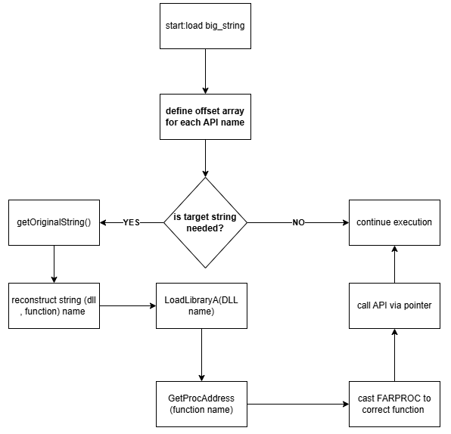
Pointer obfuscation Execution Flow
1. Initialization: Load the entire big_string into memory at program startup
2. Definition Phase: Define unique offset arrays for each required API name (these remain inert until needed)
3. Runtime Check: When program logic determines that a particular API call is necessary, test if the string has already been reconstructed
4. String Reconstruction: If needed, trigger getOriginalString() to build the target string from offsets
5. API Resolution: LoadLibraryA() (for DLL names) or GetProcAddress() (for function names)
6. Pointer Casting: Cast the returned generic FARPROC pointer to the proper function prototype
7. API Execution: Call the API using the newly cast function pointer

Slide 12
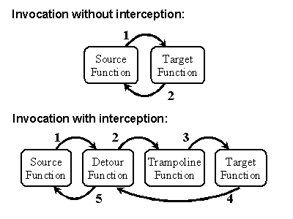
Behavior Analysis evasion
What is Hooking?
Definition:
Interception of function calls or messages to monitor or modify execution
Enables debugging, API monitoring, and extending application behavior.
First Use in Software:
Early software debuggers in the 1990s used hooking to intercept system calls
Research frameworks like Microsoft Detours popularized user-mode hooking.

Slide 13


How EDRs & AVs Use Hooking
Implementation
Targets
DLL Injection: Security agent injected into every process.
API Monitoring: Hook critical Windows APIs (NtCreateFile, NtAllocateVirtualMemory, etc.).
Behavioral Analysis: Analyze call patterns and parameters.
Real-time Response: Block, alert, or terminate suspicious activities.
File Operations: NtCreateFile, NtWriteFile, NtReadFile.
Memory Management: NtAllocateVirtualMemory, NtProtectVirtualMemory.
Process/Thread: NtCreateProcess, NtCreateThread.
Registry: NtCreateKey, NtSetValueKey
Network: WinSock APIs, HTTP functions.

Slide 14


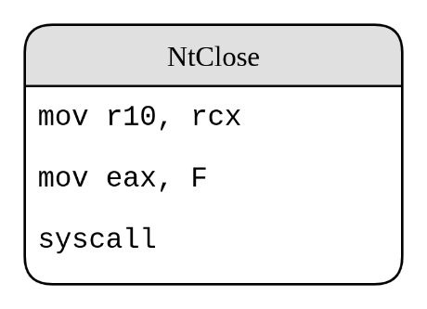
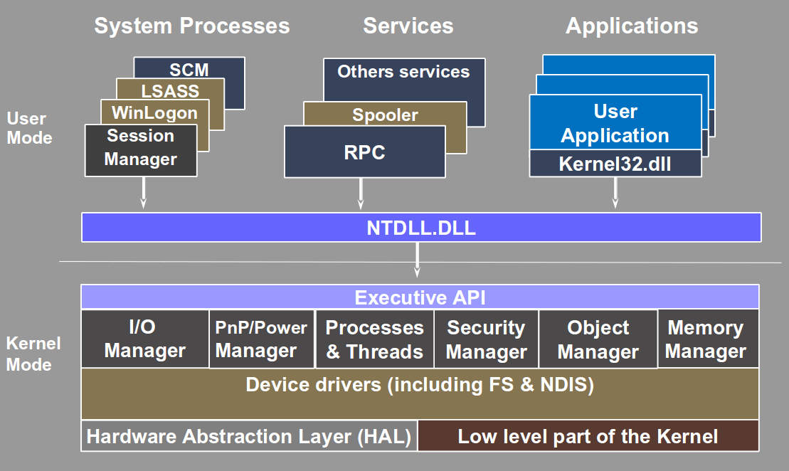

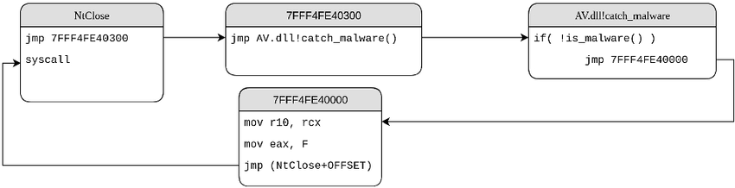
How EDRs & AVs Use Hooking
WHY NTDLL
HOOKING
14

Slide 15
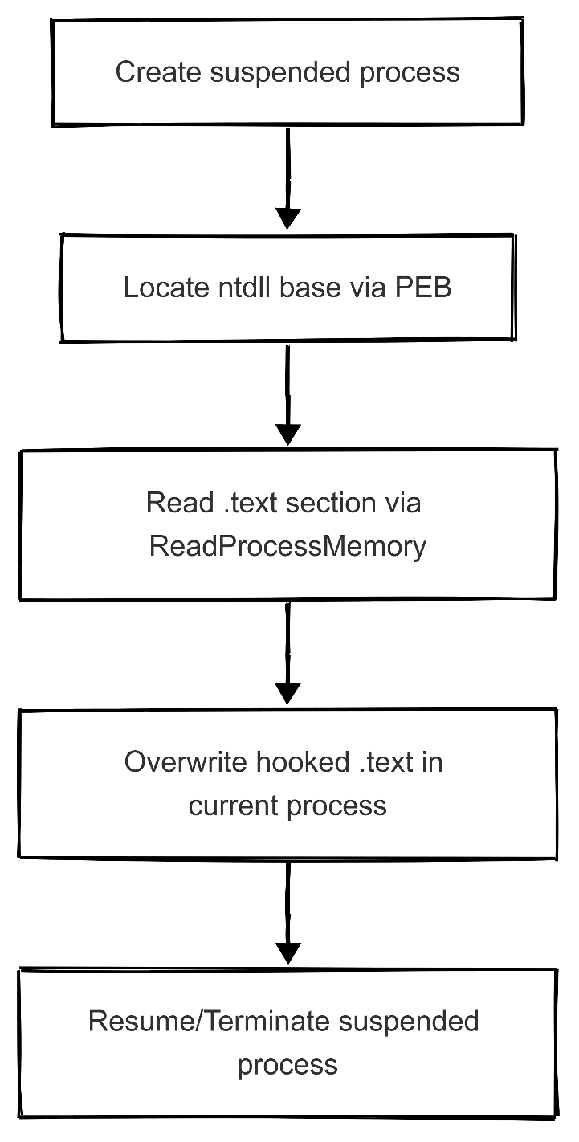
Perun's Fart Unhooking Technique
Perun: Slavic god of thunder (evokes "striking fast").
Fart: Swedish for "speed" (technique’s rapid execution).
Implementation steps:
Create Suspended Process (e.g., calc.exe).
Locate clean ntdll Base: Find ntdll.dll base address in current process.
Read Fresh Copy: Use NtReadVirtualMemory to copy clean ntdll.
Replace Hooked Stubs: Copy clean syscall stubs over hooked ones.
Cleanup: Terminate suspended process.

Slide 16


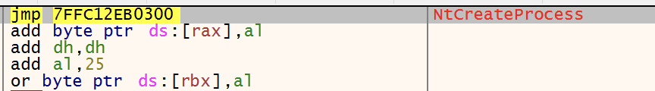

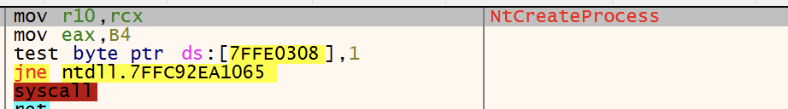
Why Perun's Fart
Advantages
Result
Clean Source: Suspended process guaranteed unhooking.
Comprehensive: Replaces all Nt* function hooks.
Stealthy: Doesn't require external files or network access.
Reliable: Works consistently across Windows versions.
Minimal Footprint: Uses legitimate Windows APIs.

Slide 17


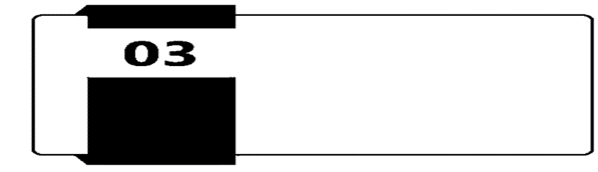

Malware Capabilities
Keylogger
Target profiler
Data Exfiltration via Telegram

Slide 18



Keylogger
Keystroke Capture
Clipboard Monitoring
Context Tracking
Unicode Support: capture all UNI symbols.
Supports detection of special keys: CTRL, ALT, SHIFT, TAB, BACKSPACE, F1-F12, navigation keys.
Captures combinations automatically: CTRL+C / CTRL+V..
Works across all apps, browsers, and text fields.
Captures full clipboard text content once program is running.
Captures any new clipboard text data:
CTRL+C, CTRL+X, CTRL+V.
Right-click Copy/Paste.
Get active window title.
Works across all apps, browser tabs.

Slide 19


Keylogger
String Stream
Random Sending Time
Store keylogger output.
Fileless Operation:
Logs stored in RAM: never touch disk.
Bypasses AV/EDR file scanners: (no keylog.txt to detect).
Empty itself after each send to C2 server .
Sending keylogger output.
Sends data to C2 server randomly between 30 to 180 seconds.
Evades network behavior analysis.
Avoids pattern-based detection.
Looks like human traffic behavior.

Slide 20
Target profiler
Purpose
Gathers detailed information about the system and system’s hardware to identify potential targets
Applications
Data Collection
System Profiling
Exploitation Planning
Defense Evasion
Persistence Mechanisms
Technology Used
Windows Management Instrumentation (WMI): Core Windows tool for system info. WMI supports WQL (WMI Query Language), to retrieve information from WMI Accesses
details like CPU, RAM, storage, OS version, Security Update ,USB and network devices.

Slide 21
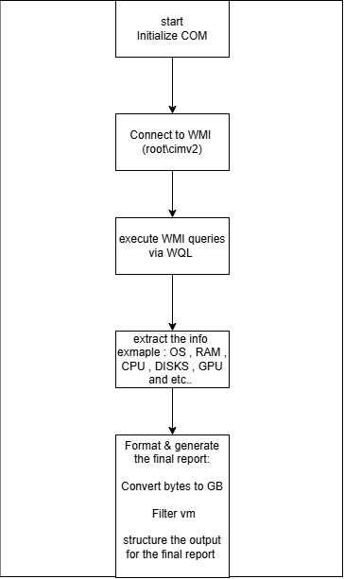
Execution Flow
1-Initialize COM
COM = Component Object Model (Windows' way to let programs talk to each other)
Required for accessing Windows management services
2-Connect to WMI (root\cimv2)
ROOT\CIMV2 = Windows' main hardware info database
3-Execute WMI queries via WQL
WQL = SQL-like language for hardware queries
Runs multiple queries for different components
4-Extract the info (OS, RAM, CPU, DISKS, GPU)
Parses COM objects into readable strings
Handles different data types (numbers, text, sizes)
5-Format & generate final report
Converts raw bytes to human-readable GB/MB
VM filter prevents analysis in virtual environment (using GPU)
structure the output of the final report

Slide 22


Data Exfiltration via Telegram
Purpose:
Sends stolen information from the victim’s device to a Telegram bot using secure communication channels.
Technology Used:
Using a low-level native Windows API for sending HTTPs requests, which make it possible to send messages with the created bot by providing the chat ID and the bot token.

Slide 23
Data Exfiltration via Telegram
Why Telegram?
End-to-End Encryption (E2EE): Ensures that only the sender and recipient can view messages, making interception nearly impossible.
Self-Destructing Messages: Allows messages or files to delete automatically after a set time, reducing evidence traces.
Device-Specific Secret Chats: Features enhanced security, like blocking screenshots and message forwarding, ensuring privacy on a single device.
Decentralized Structure: Operates globally, avoiding dependence on a single country’s data laws, and resists cooperation with governments or law enforcement.

Slide 24
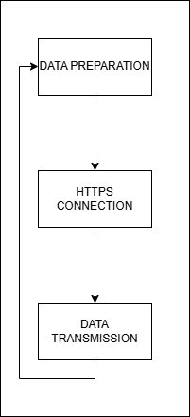
Execution Flow
1. Data Preparation
Collect system information/keystrokes
URL encode sensitive characters
Split into 4000-character chunks
2. HTTPS Connection
Connect to obfuscated api.telegram.org
Establish secure SSL/TLS channel
Authenticate with hidden bot token
3. Data Transmission
POST request to /bot{HIDDEN_TOKEN}/sendMessage
Include obfuscated chat_id and encoded text
Send each chunk sequentially

Slide 25

PROJECT TIMELINE
Bypassed Windows AV (1/2025)
Google Chrome Adds App-Bound Encryption to Protect Cookies from Malware (2/2025)
Capabilities (4/2025)
Static Evasion (5/2025)
Dynamic Evasion (5/2025)
Result (5/2025)
Performed Analysis on our malware (6/2025)
Change Research Direction (3/2025)
Windows Persistence
Enhancements
STAGE
4
STAGE
5
STAGE
1
STAGE
3
STAGE
2

Slide 26
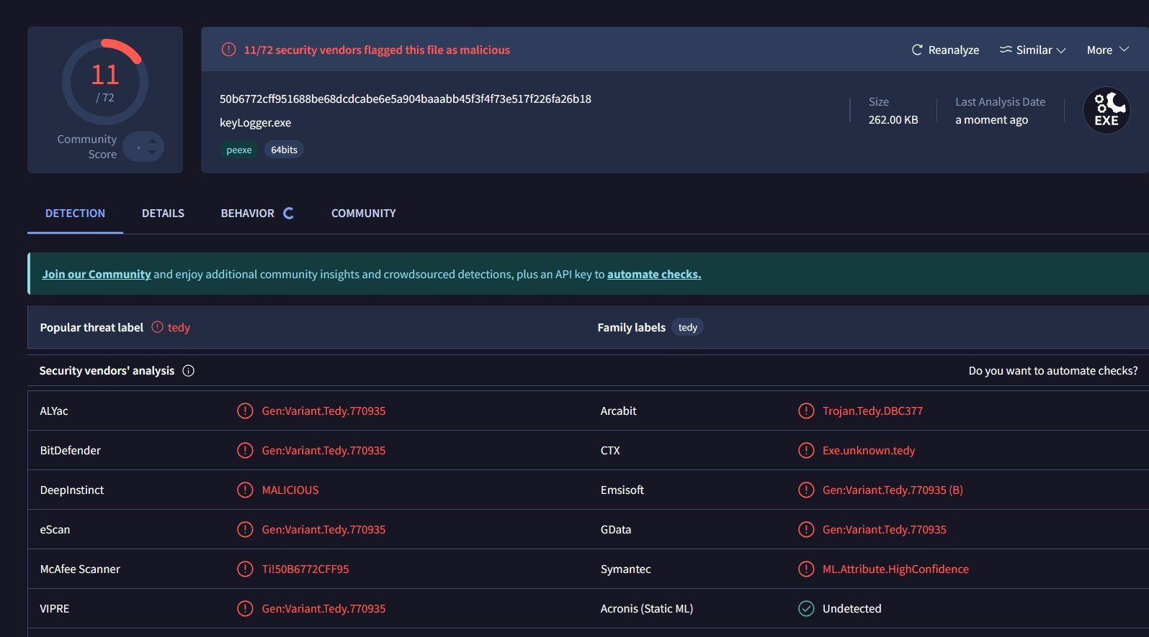
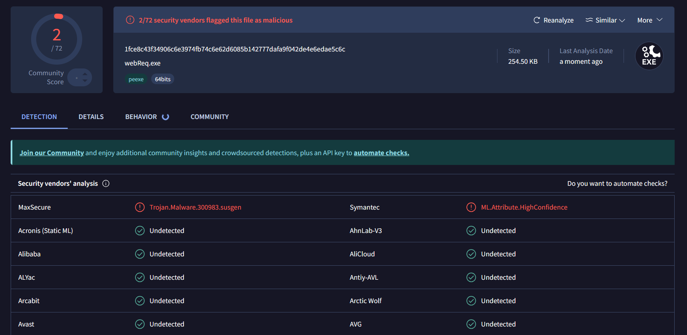
Capabilities
Static Evasion

Slide 27
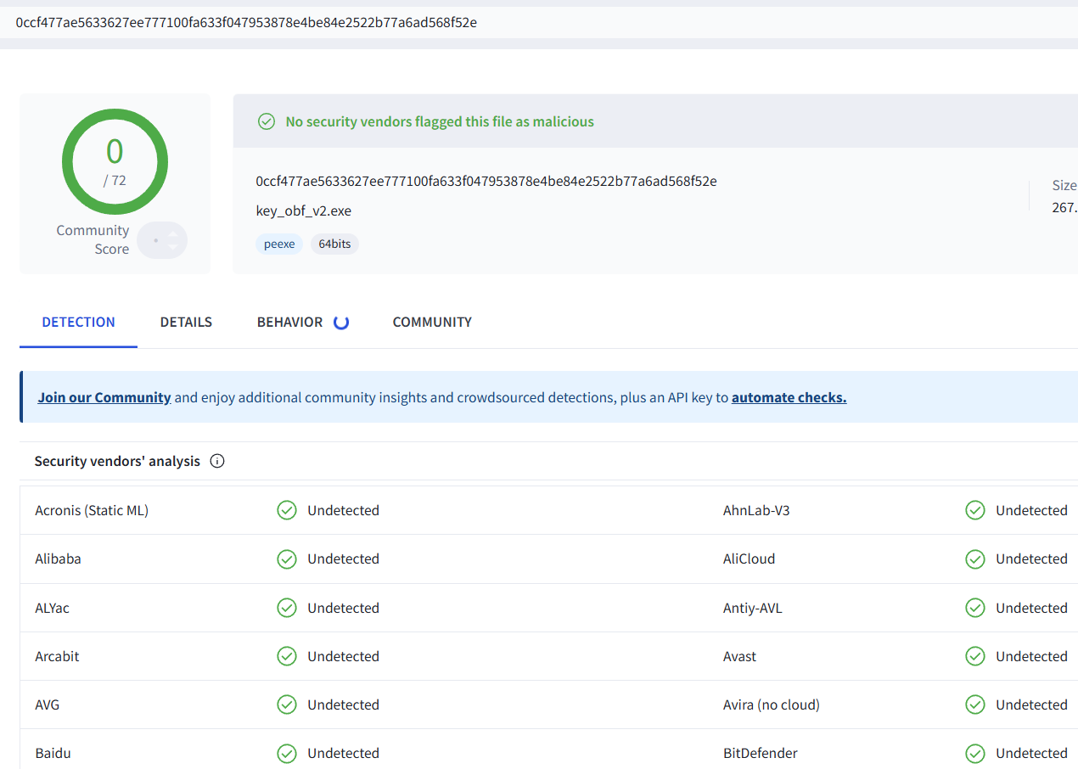
Evasion Success - VirusTotal Result
0 detections out of 70+ engines
100% evasion success rate
Status: CLEAN

Slide 28
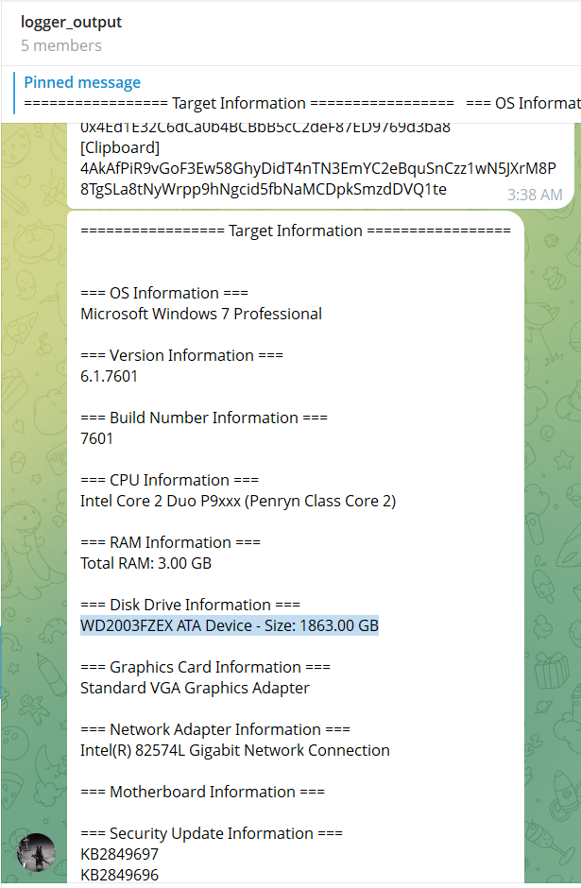
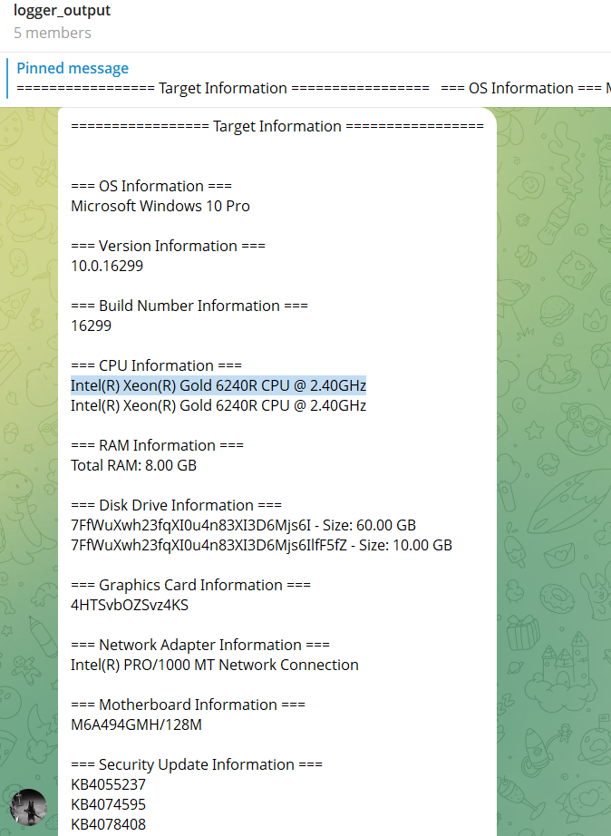

Slide 29
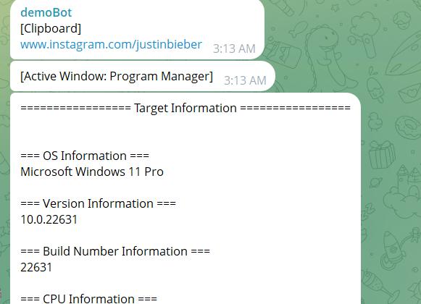
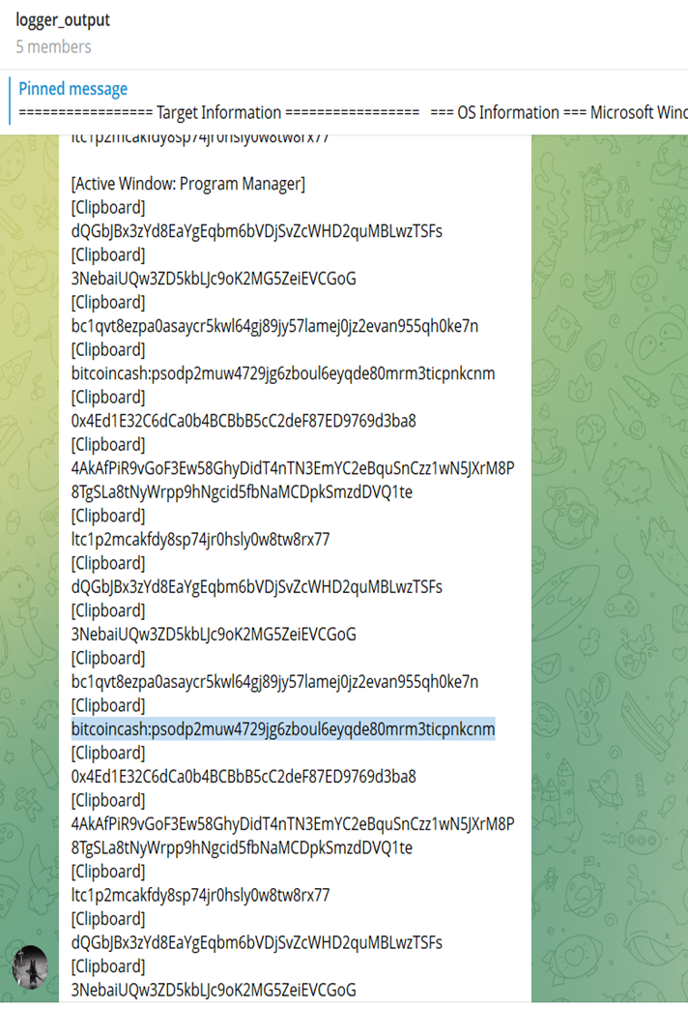

Slide 30
Practical Demo
Execution Walkthrough

